Slide 1


BDA MINI-PROJECT on
Deep Learning with RNN
Presented By:
Syed Mustaq Ahamed
1VI16CS108
8th semester, B section
Department of CSE
Guided By:
Mrs. A Roseline Mary
Assistant Professor,
Department of CSE

Slide 2
Contents
Deep learning with RNN
2020-2021
Problem Statement
Feature Engineering
Feature Selection
Preprocessing
Model Selection
Model Evaluation

Slide 3
Problem Statement
Deep learning with RNN
2020-2021
Designing a model for Predicting Emotion from Text.
Reference Link - https://www.kaggle.com/suryaaseran/emotion-prediction-from-text/notebook
E

Slide 4
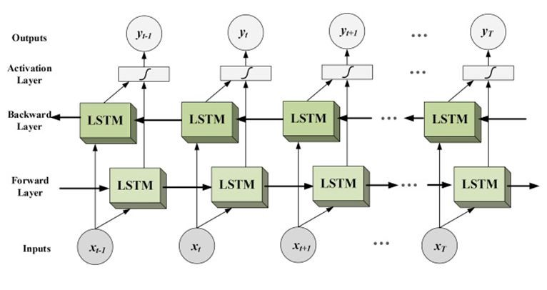
Feature Engineering
Deep learning with RNN
2020-2021
Bidirectional LSTM
A Bidirectional LSTM is a sequence processing model that consists of two LSTMs: one taking the input in a forward direction, and the other in a backwards direction.
LSTM helps preserves information from inputs that has already passed through it using the hidden state. Unidirectional LSTM only preserves information of the past because the only inputs it has seen are from the past.
Using bidirectional will run our inputs in two ways, one from past to future and one from future to past and what differs this approach from unidirectional is that in the LSTM that runs backwards you preserve information from the future and using the two hidden states combined you are able in any point in time to preserve information from both past and future.

Slide 5
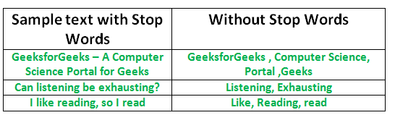
Preprocessing
Deep learning with RNN
2020-2021
Stop Words: A stop word is a commonly used word (such as “the”, “a”, “an”, “in”) that a search engine has been programmed to ignore, both when indexing entries for searching and when retrieving them as the result of a search query.
We would not want these words to take up space in our database, or taking up valuable processing time. For this, we can remove them easily, by storing a list of words that you consider to stop words. NLTK(Natural Language Toolkit) in python has a list of stopwords stored in 16 different languages. You can find them in the nltk_data directory.
home/mustaq/nltk_data/corpora/stopwords is the directory address.(Do not forget to change your home directory name)

Slide 6

How to Convert Categorical Data to Numerical Data?
Deep learning with RNN
2020-2021
In the “color” variable example, there are 3 categories and therefore 3 binary variables are needed. A “1” value is placed in the binary variable for the color and “0” values for the other colors.
For example:
The binary variables are often called “dummy variables” in other fields, such as statistics.
One-Hot Encoding
For categorical variables where no such ordinal relationship exists, the integer encoding is not enough.
In fact, using this encoding and allowing the model to assume a natural ordering between categories may result in poor performance or unexpected results (predictions halfway between categories).
1
In this case, a one-hot encoding can be applied to the integer representation. This is where the integer encoded variable is removed and a new binary variable is added for each unique integer value.

Slide 7
Model Selection
Deep learning with RNN
2020-2021
Sadness
Anger
Fear
Happy
Love
Surprise
Emotion Detection and Recognition from text is a recent field of research that is closely related to Sentiment Analysis. Sentiment Analysis aims to detect positive, neutral, or negative feelings from text, whereas Emotion Analysis aims to detect and recognize types of feelings through the expression of texts, such as Happy, sadness, anger, fear, surprise, love.
Emotions in the Model

Slide 8
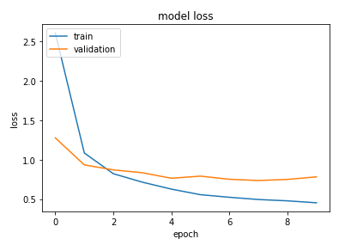
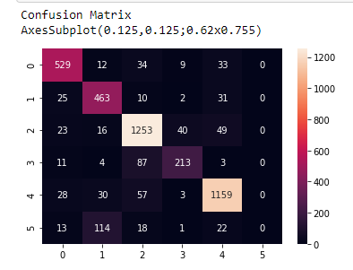
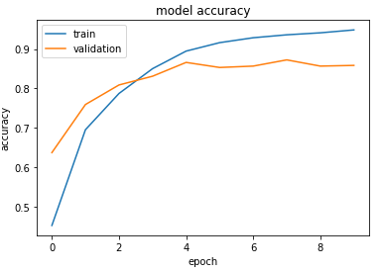
Model Evaluation
Deep learning with RNN
2020-2021
1
Model Accuracy
Model Loss
Confusion Matrix
Finally we get a Text-Emotion Predictor after training our model.

Slide 9
THANK YOU
Deep learning with RNN
2020-2021

